Slide 1
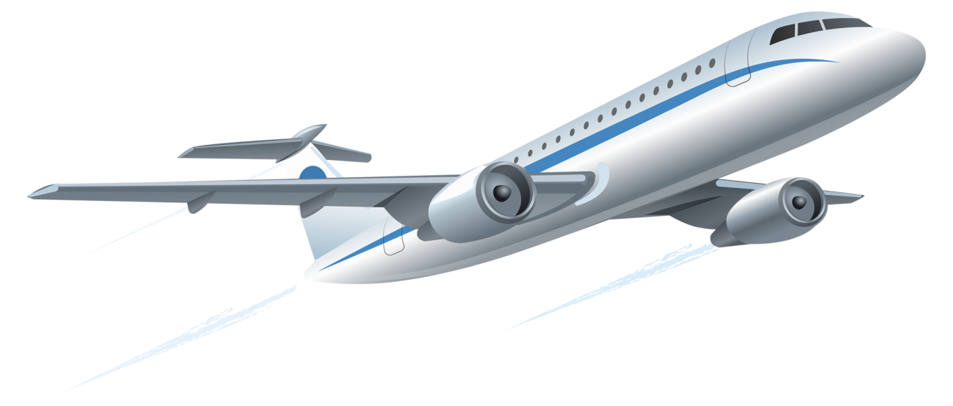
Welcome
Md. Mofakkarul Alam, Assistant Teacher, Gamruli govt. Primary School, Kendua, Netrokona.

Slide 2
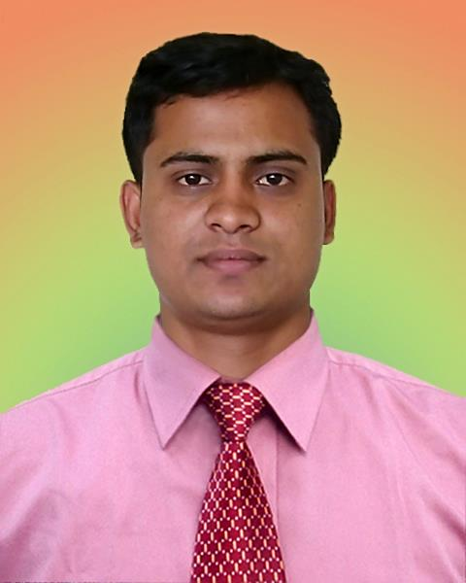
Identity
Mofakkarul Alam
Assistant Teacher
Gamruli Govt. Primary school
Kendua, Netrokona
Mobile: 01718-146163
Email: mofakkarulalam@yahoo.com
Md. Mofakkarul Alam, Assistant Teacher, Gamruli govt. Primary School, Kendua, Netrokona.

Slide 3
Let’s we sing a song.
We shall overcome
We shall overcome
We shall overcome someday
Oh deep in my heart, I do believe,
………………………………..
Md. Mofakkarul Alam, Assistant Teacher, Gamruli govt. Primary School, Kendua, Netrokona.

Slide 4
Class : One
Subject : English
Time : 45 minute
Md. Mofakkarul Alam, Assistant Teacher, Gamruli govt. Primary School, Kendua, Netrokona.

Slide 5
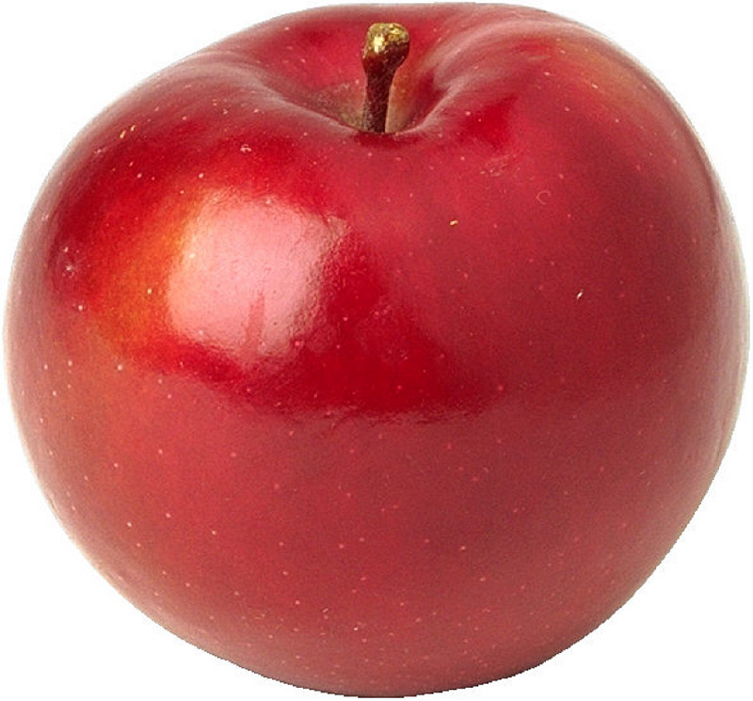
What can you see in this picture?
Ant, Apple
Md. Mofakkarul Alam, Assistant Teacher, Gamruli govt. Primary School, Kendua, Netrokona.

Slide 6
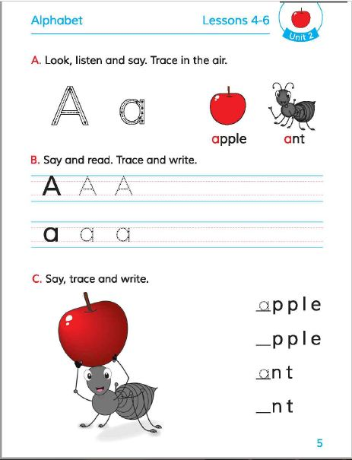
Today’s lesson
Alphabat
Unit : 2
Lessons : 4-6
Page : 5
Total students : 50
Present students: 45
Md. Mofakkarul Alam, Assistant Teacher, Gamruli govt. Primary School, Kendua, Netrokona.

Slide 7
Learning outcomes
At the end of the lesson students will be able to-
1.1.1 become familiar with English sounds by listening to common English words.
1.1.1 repeat after the teacher simple words and phrases.
1.1.2 say simple words and phrases.
1.2.1recognize and read the alphabet both small and capital (non-cursive).
1.3.1 practice letter shapes/simple writing patterns, etc.
1.2.1 write non-cursive capital letters.
Md. Mofakkarul Alam, Assistant Teacher, Gamruli govt. Primary School, Kendua, Netrokona.

Slide 8
Look, listen and say. Trace in the air.
W.C.W
Aa
ant
Md. Mofakkarul Alam, Assistant Teacher, Gamruli govt. Primary School, Kendua, Netrokona.

Slide 9
Look, listen and say. Trace in the air.
W.C.W
Aa
apple
Md. Mofakkarul Alam, Assistant Teacher, Gamruli govt. Primary School, Kendua, Netrokona.

Slide 10
Look, listen and say. Trace in the air.
W.C.W
Aa
arm
Md. Mofakkarul Alam, Assistant Teacher, Gamruli govt. Primary School, Kendua, Netrokona.

Slide 11
Say and read trace and write
a
W.C.W
A
Md. Mofakkarul Alam, Assistant Teacher, Gamruli govt. Primary School, Kendua, Netrokona.

Slide 12
Look and learn
Pair work
A
a
Md. Mofakkarul Alam, Assistant Teacher, Gamruli govt. Primary School, Kendua, Netrokona.

Slide 13
Open your English book Page 5
Md. Mofakkarul Alam, Assistant Teacher, Gamruli govt. Primary School, Kendua, Netrokona.

Slide 14
Say trace and write
Group work
nt
a
pple
a
Md. Mofakkarul Alam, Assistant Teacher, Gamruli govt. Primary School, Kendua, Netrokona.

Slide 15
Evaluation
W.C.W
a
pple
Click here
Md. Mofakkarul Alam, Assistant Teacher, Gamruli govt. Primary School, Kendua, Netrokona.

Slide 16
Evaluation
W.C.W
a
nt
Click here
Md. Mofakkarul Alam, Assistant Teacher, Gamruli govt. Primary School, Kendua, Netrokona.

Slide 17
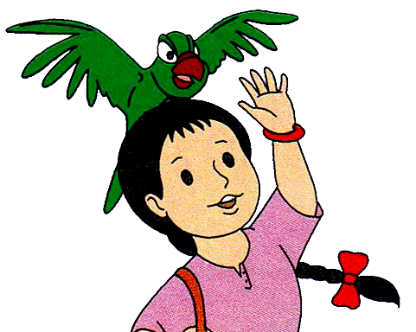
Bye bye
Md. Mofakkarul Alam, Assistant Teacher, Gamruli govt. Primary School, Kendua, Netrokona.

